Slide 1






XIX Encuentro de Cooperación Farma-Biotech
12 de noviembre de 2020
Blood-based biomarker for early diagnosis of Alzheimer’s disease
Prof. José Rodríguez Alvarez

Slide 2



XIX Encuentro de Cooperación Farma-Biotech
Problem to be solved : earlier diagnosis of Alzheimer’s disease
No AD
Situation now
Clinical
diagnosis
AD
Preclinical AD
Alzheimer’s disease
Alzheimer’s disease progression (10 to 20 years until clinical diagnosis)
Early biomarkers
Preclinical AD
AD
Desire Future
Potential therapies
No AD

Slide 3

XIX Encuentro de Cooperación Farma-Biotech
Problem to be solved : earlier diagnosis of Alzheimer’s disease
WHO estimates that 75.6 million people is expected to suffer AD by 2030.
Economical Impact
Early and accurate diagnosis could save up to $7.9 TRILLION in medical and care costs in the USA (data from Alzheimer’s Association 2019 report)
Global market for an early diagnostic tool this is expected to reach USD 12 billion by 2022 growing at a CAGR of 10%.
Why is needed?
Provides basis for early AD clinical trials. A key issue for effective drug discovery in AD.
Facilitates early non-pharmacological intervention.
Specific AD diagnosis from other dementias.

Slide 4
XIX Encuentro de Cooperación Farma-Biotech
Current Biomarkers for AD
Preclinical AD
Alzheimer’s disease
Alzheimer’s disease progression (10 to 20 years until clinical diagnosis)
Cognitive Tests
Aβ or Tau/p-Tau
Biomarkers
+
PROBLEMS: a) invasive, b) economical cost and c) not so early-biomarkers
NOT suitable for routine clinical screening (100 millions AD patients expected by 2050)
Imaging
Lumbar puncture for
Cerebrospinal fluid extraction

Slide 5

XIX Encuentro de Cooperación Farma-Biotech
Our product: Blood-based Biomarker for early AD detection
No AD
miR-92a-3p
miR-181c-5p
miR-210-3p
Preclinical AD
Our product: Plasma
miRNA signature
Blood-Based Biomarker
ADVANTAGES: a) Minimally invasive and b) cost-effective
SUITABLE for routine clinical screening
see Siedlecki-Wullich et al., Alzheimers Res Ther (2019)

Slide 6


XIX Encuentro de Cooperación Farma-Biotech
Innovative mechanisms of action
Preclinical AD
Alzheimer’s disease
Alzheimer’s disease progression (10 to 20 years until clinical diagnosis)
Synaptic dysfunction
Mild cognitive
Impairment due to AD (MCI-AD)
Early-mild AD
Moderate AD
Our signature is composed by miRNAs related to the regulation of synaptic function. Synaptic function is considered to be altered in AD well before neurodegeneration starts and a clinical diagnosis is possible
Severe AD

Slide 7
XIX Encuentro de Cooperación Farma-Biotech
Differential features
Targets early synaptic dysfunction in the AD brain
Non-invasive and cost-affordable for routine clinical screening
Facilitates specific AD diagnosis from other dementias
Could facilitate the identification of subjects with mild-cognitive impartment (MCI) that would evolve to AD from other MCI subjects that won’t evolve to AD.
Content status of development
Proof-of-concept done in plasma samples from a cohort composed with control, MCI, AD and frontotemporal dementia subjects.
Requires further validation in other cohorts worldwide with extended longitudinal studies

Slide 8
XIX Encuentro de Cooperación Farma-Biotech
IPR protection
Industrial Protection has been managed by the Technology Transfer Office of the Universidad Autónoma de Barcelona.
Priority Patent has been registered (European patent application EP 18382427.5) protecting not only the miRNAs from our signature but also all the components needed for their measurement in plasma samples and the future molecular kit that will be used for the tests (June 2018).
Filing of the International Patent (PCT; (June 2019), one year after the priority date.
Partnering Opportunities
A license agreement would be a feasible and a realistic option after validation of our data in different cohorts worldwide.

Slide 9
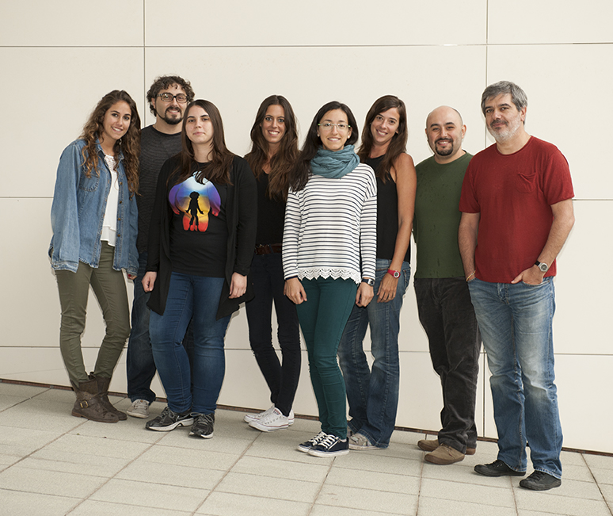

XIX Encuentro de Cooperación Farma-Biotech
Team
Project Leader: José Rodriguez Alvarez, Ph.D
Professor of Biochemistry and Molecular Biology (UAB)
Group Leader at Institut de Neurociències (UAB)
Group Leader at CIBERNED
Visiting Professor at Albert Einstein College of Medicine
(NY, USA)
Team members involved in the project
Alfredo J. Miñano Molina, Ph.D
Associate Research Scientist
Dolores Siedlecki Wullich,Ph.D
Cristina Fabregas
Ph.D Student
Lucas Martín Pinardi
(support from TTO-UAB)
  More than 20 years of EXPERTISE in neurodegeneration research.
  14 multi-year research COMPETITIVE grants and more than 60 research papers published in international journals.
  INTEREST in understanding the events related to early synaptic dysfunction in AD.
MOTIVATED to put our product on the market.

